Slide 2
What happened?
Cranky Fellas brainstormed while travelling towards venue

Slide 3

explore
tourism
visit

Slide 4
Towards Society
Medical Tourism
Growth from $3 billion to $7 billion by 2020 Growth up-to $460 billion by 2028 (9.9% of GDP)
Virtual Tour

Slide 5





Tech Stack

Slide 6
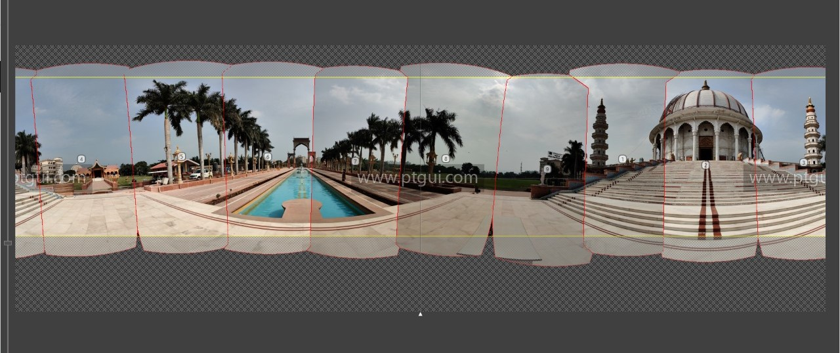
Photo Stitching

Slide 7
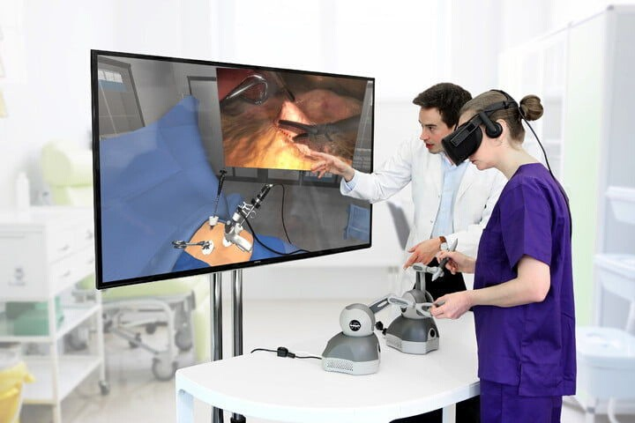
Future Roadmap
1
Simulations
2
Virtual Classes

Slide 8



Cranky Fellas
Suraj Maharana
Rushank Jain
Omkar Ingale Ajay Kumar
Thanks to
Next Tech Lab AP

Slide 9
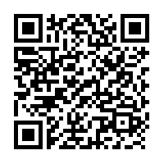
Virtual Tour of
MIT University

